Slide 1
Mining Frequent Patterns, Associations and Correlations

Slide 2
What Is Frequent Pattern Analysis?
Frequent pattern: a pattern (a set of items, subsequences, substructures, etc.) that occurs frequently in a data set
    Eg: milk and bread
A set of items that appear frequently together in a transaction data set is a frequent itemset.
A subsequence, such as buying first a PC, then a digital camera, and then a memory card, if it occurs frequently in a shopping history database, is a (frequent) sequential pattern.
A substructure can refer to different structural forms, such as subgraphs, subtrees, or sublattices, which may be combined with itemsets or subsequences.
If a substructure occurs frequently, it is called a (frequent) structured pattern.

Slide 3
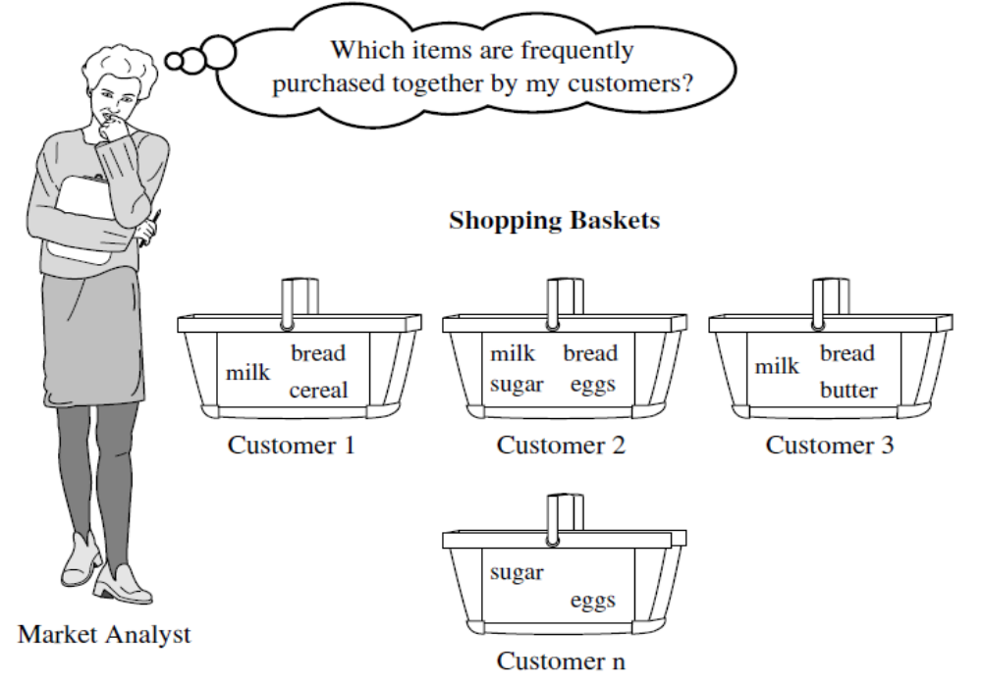

Slide 4
Frequent pattern mining searches for recurring relationships in a given data set
Motivation: Finding inherent regularities in data
  What products were often purchased together?
  What are the subsequent purchases after buying a PC?
  What kinds of DNA are sensitive to this new drug?
  Can we automatically classify web documents?
Applications
  Basket data analysis, cross-marketing, catalog design, sale campaign analysis, Web log (click stream) analysis, and DNA sequence analysis.

Slide 5
Consider the set of items available at the store, then each item has a Boolean variable representing the presence or absence of that item.
Each basket can then be represented by a Boolean vector of values assigned to these variables.
The Boolean vectors can be analyzed for buying patterns that reflect items that are frequently associated or purchased together.
These patterns can be represented in the form of association rules.

Slide 6
Rule support and confidence are two measures of rule interestingness.
They respectively reflect the usefulness and certainty of discovered rules.
Eg:
Computer=>antivirus software [support = 2%, confidence = 60%]
Association rules are considered interesting if they satisfy both a minimum support threshold and a minimum confidence threshold.
Such thresholds can be set by users or domain experts.

Slide 7
Why Is Freq. Pattern Mining Important?
Discloses an intrinsic and important property of data sets
Forms the foundation for many essential data mining tasks
  Association, correlation, and causality analysis
  Sequential, structural (e.g., sub-graph) patterns
  Pattern analysis in spatiotemporal, multimedia, time-series, and stream data
  Classification: associative classification
  Cluster analysis: frequent pattern-based clustering
  Data warehousing: iceberg cube and cube-gradient
  Semantic data compression: fascicles
  Broad applications

Slide 8
Frequent Itemsets, Closed Itemsets, and Association Rules
Support (A=>B) = P(AUB)
Confidence (A=>B) = P(B/A)
Rules that satisfy both a minimum support threshold (min sup) and a minimum confidence threshold (min conf) are called strong.
A set of items is referred to as an itemset
An itemset that contains k items is a k-itemset.
The set {computer, antivirus software} is a 2-itemset.
The occurrence frequency of an itemset is the number of transactions that contain the itemset.
This is also known as the frequency, support count, or count of the itemset.

Slide 9
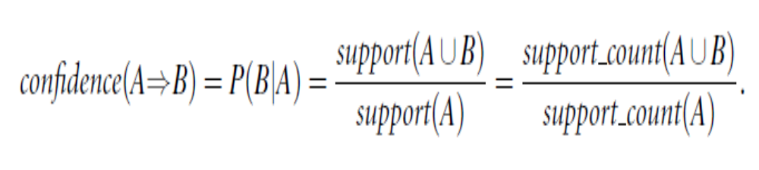
If the relative support of an itemset I satisfies a prespecified minimum support threshold then I is a frequent itemset.
The set of frequent k-itemsets is commonly denoted by L_{k}

Slide 10
Association rule mining can be viewed as a two-step process:
Find all frequent itemsets:
  By definition, each of these itemsets will occur at least as frequently as a predetermined minimum support count, min sup.
Generate strong association rules from the frequent itemsets:
  By definition, these rules must satisfy minimum support and minimum confidence.

Slide 11
Itemset X = {x₁, …, x_{k}}
Find all the rules X → Y with minimum support and confidence
  support, s, probability that a transaction contains X ∪ Y
  confidence, c, conditional probability that a transaction having X also contains Y
Customer
buys both
Customer
buys milk
Customer
buys bread

Slide 12
Closed Patterns and Max-Patterns
A long pattern contains a combinatorial number of sub-patterns,
  e.g., {a₁, …, a₁₀₀} contains (₁₀₀¹) + (₁₀₀²) + … + (₁¹₀⁰₀⁰) = 2¹⁰⁰ – 1 = 1.27*10³⁰ sub-patterns!
Solution: Mine closed patterns and max-patterns instead
An itemset X is closed in a data set S if there exists no proper super-itemset Y such that Y has the same support count as X in S.
An itemset X is a max-pattern (or max-itemset) if X is frequent and there exists no super-itemset Y such that X is a subset of Y and Y is frequent in S.

Slide 13
Frequent pattern mining can be classified in various ways, based on the following criteria:
Based on the completeness of patterns to be mined
Based on the levels of abstraction involved in the rule set
Based on the number of data dimensions involved in the rule
Based on the types of values handled in the rule
Based on the kinds of rules to be mined
Based on the kinds of patterns to be mined

Slide 14
Based on the completeness of patterns to be mined:
we can mine (given a minimum support threshold)
  The complete set of frequent itemsets,
  The closed frequent itemsets,
  The maximal frequent itemsets,
  The constrained frequent itemsets (i.e., those that satisfy a set of user-defined constraints),
  The approximate frequent itemsets (i.e., those that derive only approximate support counts for the mined frequent itemsets),
  Near-match frequent itemsets (i.e., those that tally the support count of the near or almost matching itemsets),
  Top-k frequent itemsets (i.e., the k most frequent itemsets for a user-specified value, k),
  and so on.

Slide 15
Based on the levels of abstraction involved in the rule set:
Some methods for association rule mining can find rules at differing levels of abstraction
  Multilevel Association rules
  Single-level Association rules

Slide 16
Based on the number of data dimensions involved in the rule
If the items or attributes in an association rule reference only one dimension, then it is a single-dimensional association rule.
If a rule references two or more dimensions, then it is a multidimensional association rule.

Slide 17
Based on the types of values handled in the rule
If a rule involves associations between the presence or absence of items, it is a Boolean association rule.
If a rule describes associations between quantitative items or attributes, then it is a Quantitative association rule.

Slide 18
Based on the kinds of rules to be mined
Frequent pattern analysis can generate various kinds of rules and other interesting relationships.
Association rules are the most popular kind of rules generated from frequent patterns.
the discovered associations can be further analyzed to uncover statistical correlations, leading to correlation rules.
We can also mine strong gradient relationships among itemsets,
  where a gradient is the ratio of the measure of an item when compared with that of its parent (a generalized itemset), its child (a specialized itemset), or its sibling (a comparable itemset).

Slide 19
Based on the kinds of patterns to be mined
Many kinds of frequent patterns can be mined from different kinds of data sets.
Frequent itemset mining - mining of frequent itemsets (sets of items) from transactional or relational data sets.
Sequential pattern mining searches for frequent subsequences in a sequence data set, where a sequence records an ordering of events.
Structured pattern mining searches for frequent substructures in a structured data set.
(structure is a general concept that covers many different kinds of structural forms, such as graphs, lattices, trees, sequences, sets,single items, or combinations of such structures. Single items are the simplest form of structure. Each element of an itemset may contain a subsequence, a subtree, and so on,)

Slide 20
Efficient and Scalable Frequent Itemset Mining Methods
simplest form of frequent patterns
  single-dimensional, single-level, Boolean frequent itemsets
methods for mining the simplest form of frequent patterns
  Apriori, the basic algorithm for finding frequent itemsets Using Candidate Generation
  Frequent-pattern growth (FP-growth), An interesting method which adopts a divide-and-conquer strategy without candidate generation

Slide 21
The Apriori Algorithm:
Finding Frequent Itemsets Using
Candidate Generation

Slide 22
The name of the algorithm is based on the fact that the algorithm uses prior knowledge of frequent itemset properties
Apriori employs an iterative approach known as a level-wise search, where k-itemsets are used to explore (k+1)-itemsets.
First, the set of frequent 1-itemsets is found by scanning the database to accumulate the count for each item, and collecting those items that satisfy minimum support.
The resulting set is denoted L₁.Next, L₁ is used to find L₂, the set of frequent 2-itemsets, which is used to find L₃, and so on, until no more frequent k-itemsets can be found.
The finding of each L_{k} requires one full scan of the database.

Slide 23
To improve the efficiency of the level-wise generation of frequent itemsets, an important property called the Apriori property is used to reduce the search space.
Apriori property:
All nonempty subsets of a frequent itemset must also be frequent.
The Apriori property is based on the following observation. By definition, if an itemset I does not satisfy the minimum support threshold, min sup, then I is not frequent; that is, P(I) < min sup.
Therefore, I U A is not frequent either; that is, P(I U A) < min sup.

Slide 24
This property belongs to a special category of properties called antimonotone in the sense that if a set cannot pass a test, all of its supersets will fail the same test as well.
It is called antimonotone because the property is monotonic in the context of failing a test

Slide 25
Apriori: A Candidate Generation and Test Approach
Apriori pruning principle: If there is any itemset which is infrequent, its superset should not be generated / tested.

Slide 26
Algorithm: Apriori.
Find frequent itemsets using an iterative level-wise approach based on candidate generation.
Input:
  D, a database of transactions;
  min sup, the minimum support count threshold.
Output:
  L, frequent itemsets in D.

Slide 27
Method:
  Initially, scan DB once to get frequent 1-itemset
  Generate length (k+1) candidate itemsets from length k frequent itemsets
  Test the candidates against DB
  Terminate when no frequent or candidate set can be generated

Slide 28
The Apriori Algorithm
Pseudo-code:
    C_{k}: Candidate itemset of size k
    L_{k} : frequent itemset of size k
    L₁ = {frequent items};
    for (k = 1; L_{k} !=∅; k++) do begin
    C_{k+1} = candidates generated from L_{k}
    for each transaction t in database do
      increment the count of all candidates in C_{k+1} that are contained in t
    L_{k+1} = candidates in C_{k+1} with min_support
    end
    return ∪_{k} L_{k}

Slide 29
The Apriori Algorithm—An Example
Minimum support = 2
Transactional Database
(TDB)
C₁
Itemset | sup
{A} | 2
{B} | 3
{C} | 3
{D} | 1
{E} | 3
Itemset | sup
{A} | 2
{B} | 3
{C} | 3
{E} | 3
Tid | Items
10 | A, C, D
20 | B, C, E
30 | A, B, C, E
40 | B, E
L₁
1st scan
C₂
C₂
Itemset
{A, B}
{A, C}
{A, E}
{B, C}
{B, E}
{C, E}
Itemset | sup
{A, B} | 1
{A, C} | 2
{A, E} | 1
{B, C} | 2
{B, E} | 3
{C, E} | 2
L₂
Itemset | sup
{A, C} | 2
{B, C} | 2
{B, E} | 3
{C, E} | 2
2nd scan
Itemset
{B,C,E}
3rd scan
C₃
Itemset | sup
{B, C, E} | 2
L₃
L₄ avoided -> less than min support

Slide 30
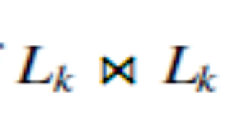
“How is the Apriori property used in the algorithm?”
A two-step process is followed
  Join step
    is equivalent to L_{k} X L_{k}
    self-joining L_{k} eg: abcd from abc and abd
  prune step.
Itemset | sup
{A,C,B} | 1
{A,B,E} | 1
{A,C,E} | 1
{B,C,E} | 2
C₃

Slide 31
Challenges of Frequent Pattern Mining
Challenges
  Multiple scans of transaction database
  Huge number of candidates
  Tedious workload of support counting for candidates
Improving Apriori: general ideas
  Reduce passes of transaction database scans
  Shrink number of candidates
  Facilitate support counting of candidates

Slide 32
Improving the Efficiency of Apriori
Several variations are there. 5 of them are given below:
  Hash-based technique
    hashing itemsets into corresponding buckets
    A k-itemset whose corresponding hashing bucket count is below the threshold cannot be frequent
  Transaction reduction
    reducing the number of transactions scanned in future iterations
    A transaction that does not contain any frequent k-itemset is useless in subsequent scans
  Partitioning
    partitioning the data to find candidate itemsets
    Any itemset that is potentially frequent in DB must be frequent in at least one of the partitions of DB

Slide 33
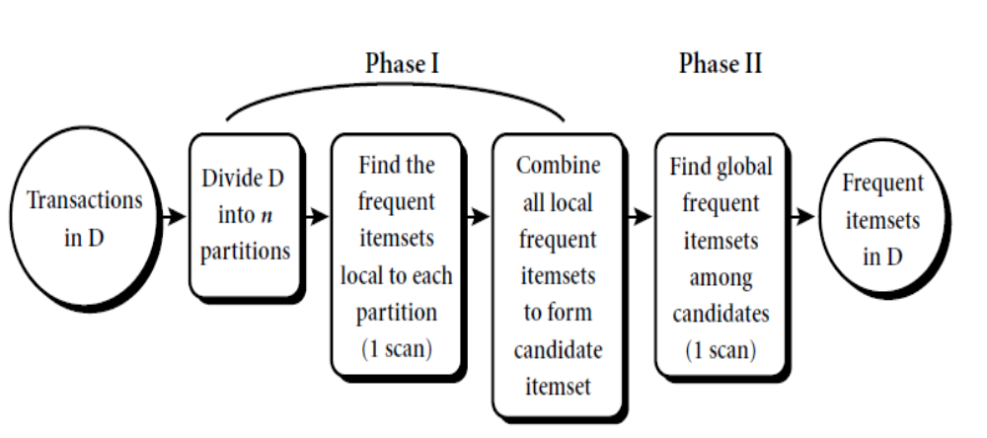
Mining by partitioning the data

Slide 34
  Sampling
    mining on a subset of the given data
    Mining in a subset of given data, lower support threshold + a method to determine the completeness.
  Dynamic itemset counting
    adding candidate itemsets at different points during a scan
    Add new candidate itemsets only when all of their subsets are estimated to be frequent.

Slide 35
Bottleneck of Frequent - pattern Mining
Multiple database scans are costly
Mining long patterns needs many passes of scanning and generates lots of candidates
Bottleneck: candidate-generation-and-test
Can we avoid candidate generation?

Slide 36
Mining Frequent Itemsets without
Candidate Generation

Slide 37
The Apriori candidate generate-and-test method significantly reduces the size of candidate sets, leading to good performance gain.
But it suffer from two nontrivial costs:
  It may need to generate a huge number of candidate sets
  It may need to repeatedly scan the database and check a large set of candidates by pattern
  matching.
An interesting method in this attempt is called frequent-pattern growth, or simply FP-growth, which adopts a divide-and-conquer strategy

Slide 38
FP Growth
First, it compresses the database representing frequent items into a frequent-pattern tree, or FP-tree, which retains the itemset association information.
It then divides the compressed database into a set of conditional databases (a special kind of projected database), each associated with one frequent item or “pattern fragment,” and mines each such database separately.

Slide 39
The FP-growth algorithm: mine frequent itemsets using an FP-tree by pattern fragment growth.
Input:
D, a transaction database
min_sup, the minimum support count threshold
Output: the complete set of frequent patterns.
Method:
(1) the FP-tree is constructed
(2) The FP-tree is mined by calling FP-growth
(FP_tree, null)

Slide 40
Method to Construct FP Tree
Scan the database D once. Collect F, the set of frequent items and their support counts. Sort F in support count descending order as L, the list of frequent items.
Create the root of an FP tree and label it as “null”. Then select and sort the frequent items for each transaction according to the order of L. Each transaction is inserted as a node as follows:
    If transaction has a child N such that N.item-name = p.item name, then increment N’s count by 1
    Else create a new node N and lets its count be 1 (parent link be linked to T)
    Recursively do the processes until items in each transaction are inserted.

Slide 41
Method to Mine FP Tree
procedure FP_growth(Tree, α)
if Tree contains a single path P then
  for each combination (denoted as β) of the nodes in the path P
    generate pattern βUα with support_count = minimum support count of nodes in β;
else for each a_{i} in the header of Tree {
  generate pattern β=a_{i}Uα with support_count = a_{i}.support_count
  construct β’s conditional pattern base and then β’s conditional FP_tree Tree_{β};
  if Treeβ != 0 then
    call FP_growth(Tree_{β}, β); }

Slide 42
Major steps to mine FP tree
Construct conditional pattern base for each node in the FP tree
Construct conditional FP tree from each conditional pattern base
Recursively mine conditional FP tree a and grow frequent patterns obtained so far
  If the conditional FP tree contains a single path, simply enumerate all the patterns.

Slide 43
Eg: for FP growth algorithm
Transactional data
TID | List of item_IDs
T100 | I1,I2,I5
T200 | I2,I4
T300 | I2,I3
T400 | I1,I2,I4
T500 | I1,I3
T600 | I2,I3
T700 | I1,I3
T800 | I1,I2,I3,I5
T900 | I1,I2,I3
the list of frequent items in descending order, L
Item _ID | Support count
I2 | 7
I1 | 6
I3 | 6
I4 | 2
I5 | 2

Slide 44
1. Transaction in db: I1,I2,I5
Order in L: I2,I1,I5
2. Transaction in db: I2,I4
Order in L: I2,I4
3. Transaction in db: I2,I3
Order in L: I2,I3
NULL
NULL
NULL
I2:1
I2:2
I2:3
I1:1
I1:1
I4:1
I1:1
I5:1
I4:1
I5:1
I5:1
I3:1
4. Transaction in db: I1,I2,I4
Order in L: I2,I1,I4
5. Transaction in db: I1,I3
Order in L: I1,I3
6. Transaction in db: I2,I3
Order in L: I2,I3
NULL
NULL
NULL
I2:4
I1:1
I1:1
I2:4
I2:5
I1:2
I4:1
I1:2
I1:2
I5:1
I4:1
I3:1
I4:1
I3:1
I3:1
I5:1
I3:1
I5:1
I3:2
I4:1
I4:1
I4:1

Slide 45
7. Transaction in db: I1,I3
Order in L: I1,I3
8. Transaction in db: I1,I2,I3,I5
Order in L: I2,I1,I3,I5
NULL
I1:2
NULL
I2:5
I1:2
I1:2
I2:6
I4:1
I3:2
I1:3
I5:1
I3:2
I4:1
I3:2
I5:1
I3:2
I4:1
I3:1
I4:1
I5:1

Slide 46
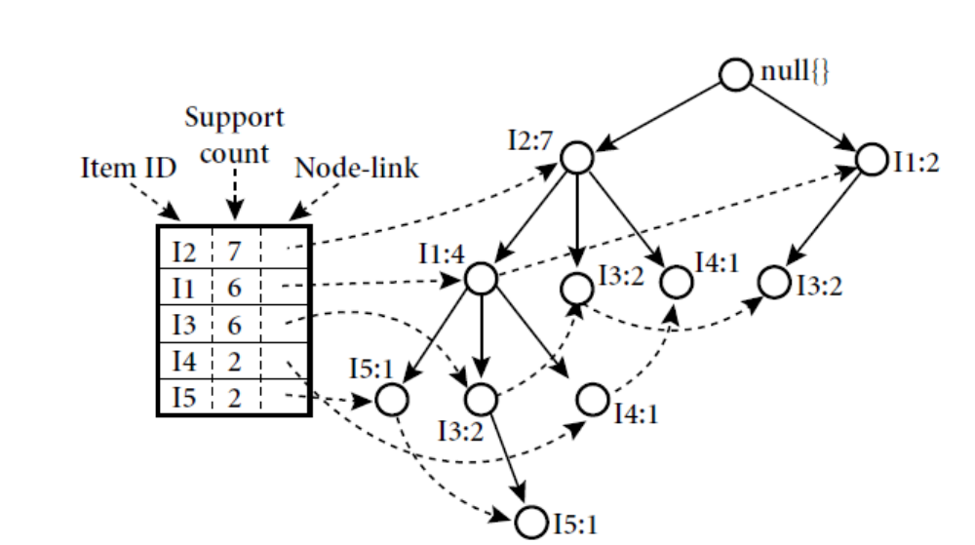
9. Transaction in db: I1,I2,I3
Order in L: I2,I1,I3
NULL
I1:2
I2:7
I1:4
I4:1
I3:2
I5:1
I3:2
I3:3
I4:1
I5:1
An FP-tree registers compressed, frequent pattern information

Slide 47
Scan DB once, find frequent 1-itemset (single item pattern)
Sort frequent items in frequency descending order, f-list
Scan DB again, construct FP-tree
Construct FP-tree from a Transaction Database

Slide 48
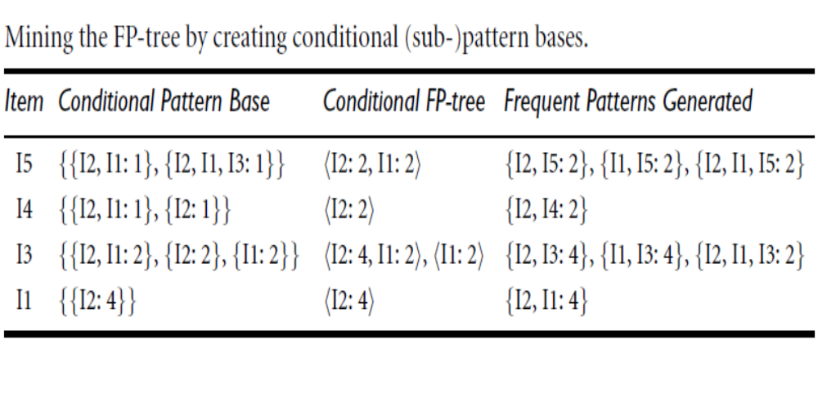

Slide 49
Benefits of the FP-tree Structure
Completeness
  Preserve complete information for frequent pattern mining
  Never break a long pattern of any transaction
Compactness
  Reduce irrelevant info—infrequent items are gone
  Items in frequency descending order: the more frequently occurring, the more likely to be shared
  Never be larger than the original database (not count node-links and the count field)
  For Connect-4 DB, compression ratio could be over 100

Slide 50
Why Is FP-Growth the Winner?
Divide-and-conquer:
  decompose both the mining task and DB according to the frequent patterns obtained so far
  leads to focused search of smaller databases
Other factors
  no candidate generation, no candidate test
  compressed database: FP-tree structure
  no repeated scan of entire database
  basic ops—counting local freq items and building sub FP-tree, no pattern search and matching
Data Mining: Concepts and Techniques

Slide 51
Mining Frequent Itemsets Using Vertical Data Format
Both the Apriori and FP-growth methods mine frequent patterns from a set of transactions in TID-itemset format (that is, {TID : itemset}), where TID is a transaction-id and itemset is the set of items bought in transaction TID.
This data format is known as horizontal data format.
Data can also be presented in item-TID set format (that is, {item : TID set}), where item is an item name, and TID set is the set of transaction identifiers containing the item.
This format is known as vertical data format.
ECLAT (Equivalence CLASS Transformation) algorithm for mining frequent item set using vertical data format

Slide 52
Implications of the Methodology
Mining closed frequent itemsets and max-patterns
  CLOSET
Mining sequential patterns
  FreeSpan, PrefixSpan
Constraint-based mining of frequent patterns
  Convertible constraints
Computing iceberg data cubes with complex measures
  H-tree and H-cubing algorithm
Data Mining: Concepts and Techniques

Slide 53
Mining Various Kinds of Association Rules
Mining multilevel association rules
Miming multidimensional association
Mining quantitative association
Mining interesting correlation patterns
Data Mining: Concepts and Techniques

Slide 54
Mining Multiple-Level Association Rules
Items often form hierarchies
Flexible support settings
  Items at the lower level are expected to have lower support
Exploration of shared multi-level mining
  Uniform support
  Reduced support

Slide 55
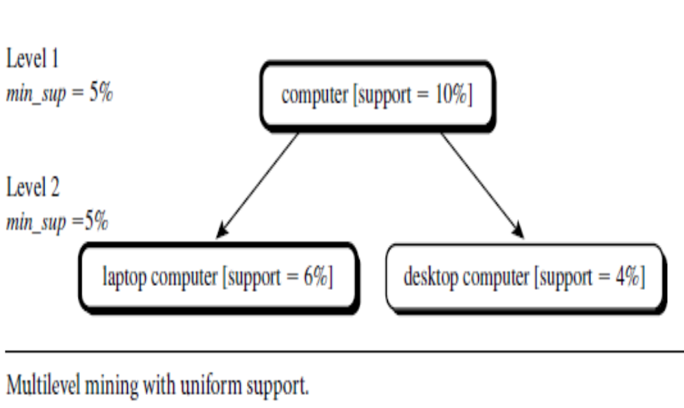

Slide 56
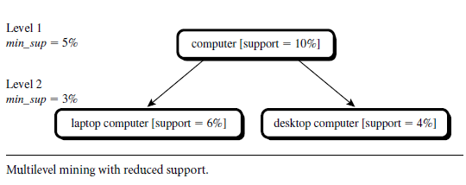

Slide 57
Mining Multi-Dimensional Association
Single-dimensional association rules (or intra dimensional association rule) :
    buys (X, “milk”) ⇒ buys (X, “bread”)
  it contains a single distinct predicate (e.g., buys) with multiple occurrences (i.e., the predicate occurs more than once within the rule)
Multi-dimensional association rules:
  age (X, “20…29”) Λ occupation (X, “student”) => buys (X, “laptop”)
  Association rules that involve two or more dimensions or predicates
  Inter-dimension assoc. rules (Multidimensional association rules with no repeated predicates)
    age(X,”19-25”) Λ occupation (X, “student”) ⇒ buys (X, “coke”)
  hybrid-dimension assoc. rules (multidimensional association
  rules with repeated predicates, which contain multiple occurrences of some predicates)
    age (X,”19-25”) Λ buys (X, “popcorn”) ⇒ buys (X, “coke”)

Slide 58
Categorical Attributes:
  have a finite number of possible values, with no ordering among the values — data cube approach
  They are also called nominal attributes, because their values are “names of things.”
Quantitative Attributes: numeric and have an implicit ordering among values—discretization, clustering, and gradient approaches

Slide 59
Mining Quantitative Associations
Techniques can be categorized by how numerical attributes, such as age or salary are treated
Static discretization based on predefined concept hierarchies (data cube methods)
Dynamic discretization based on data distribution
Clustering: Distance-based association
  one dimensional clustering then association
Deviation
  Sex = female => Wage: mean=$7/hr (overall mean = $9)

Slide 60
Static Discretization of Quantitative Attributes
Discretized prior to mining using concept hierarchy.
Numeric values are replaced by ranges.
In relational database, finding all frequent k-predicate sets will require k or k+1 table scans.
Data cube is well suited for mining.
The cells of an n-dimensional
  cuboid correspond to the
  predicate sets.
Mining from data cubes
can be much faster.
()
(age)
(income)
(buys)
(age, income)
(age,buys)
(income,buys)
(age,income,buys)

Slide 61

Quantitative Association Rules
Numeric attributes are dynamically discretized
  Such that the confidence or compactness of the rules mined is maximized
2-D quantitative association rules: A_{quan1} ∧ A_{quan2} ⇒ A_{cat}
Cluster adjacent association
rules to form general
rules using a 2-D grid
Example
Age (X,”34-35”) ∧ Income (X,”30 - 50K”)
⇒ Buys (X,”high resolution TV”)
Data Mining: Concepts and Techniques

Slide 62
Constraint-Based Association Mining
Allow users to focus the search for rules by providing meta rules and additional mining constraints
The users specify their intuition or expectations as constraints to confine the search space. This strategy is known as constraint-based mining.
The constraints can include the following:
  Knowledge type constraints: These specify the type of knowledge to be mined, such as association or correlation.
  Data constraints: These specify the set of task-relevant data.
  Dimension/level constraints: These specify the desired dimensions (or attributes) of the data, or levels of the concept hierarchies, to be used in mining.
  Interestingness constraints: These specify thresholds on statistical measures of rule interestingness, such as support, confidence, and correlation.
  Rule constraints: These specify the form of rules to be mined.
    Such constraints may be expressed as metarules (rule templates), as the maximum or minimum number of predicates that can occur in the rule antecedent or consequent, or as relationships among attributes, attribute values, and/or aggregates.

Slide 64
Multi-level Association: Redundancy Filtering
Some rules may be redundant due to “ancestor” relationships between items.
Example
  milk ⇒ wheat bread [support = 8%, confidence = 70%]
  2% milk ⇒ wheat bread [support = 2%, confidence = 72%]
We say the first rule is an ancestor of the second rule.
A rule is redundant if its support is close to the “expected” value, based on the rule’s ancestor.
Data Mining: Concepts and Techniques

Slide 65
MaxMiner: Mining Max-patterns
1st scan: find frequent items
  A, B, C, D, E
2nd scan: find support for
  AB, AC, AD, AE, ABCDE
  BC, BD, BE, BCDE
  CD, CE, CDE, DE,
Since BCDE is a max-pattern, no need to check BCD, BDE, CDE in later scan
Tid | Items
10 | A,B,C,D,E
20 | B,C,D,E,
30 | A,C,D,F
Potential max-patterns
Data Mining: Concepts and Techniques

Slide 66
Mining Frequent Closed Patterns: CLOSET
Flist: list of all frequent items in support ascending order
  Flist: d-a-f-e-c
Divide search space
  Patterns having d
  Patterns having d but no a, etc.
Find frequent closed pattern recursively
  Every transaction having d also has cfa → cfad is a frequent closed pattern
Min_sup=2
TID | Items
10 | a, c, d, e, f
20 | a, b, e
30 | c, e, f
40 | a, c, d, f
50 | c, e, f
Data Mining: Concepts and Techniques

Slide 67
CLOSET+: Mining Closed Itemsets by Pattern-Growth
Itemset merging: if Y appears in every occurrence of X, then Y is merged with X
Sub-itemset pruning: if Y כ X, and sup(X) = sup(Y), X and all of X’s descendants in the set enumeration tree can be pruned
Hybrid tree projection
  Bottom-up physical tree-projection
  Top-down pseudo tree-projection
Item skipping: if a local frequent item has the same support in several header tables at different levels, one can prune it from the header table at higher levels
Efficient subset checking
Data Mining: Concepts and Techniques

Slide 68
CHARM: Mining by Exploring Vertical Data Format
Vertical format: t(AB) = {T₁₁, T₂₅, …}
  tid-list: list of trans.-ids containing an itemset
Deriving closed patterns based on vertical intersections
  t(X) = t(Y): X and Y always happen together
  t(X) ⊂ t(Y): transaction having X always has Y
Using diffset to accelerate mining
  Only keep track of differences of tids
  t(X) = {T₁, T₂, T₃}, t(XY) = {T₁, T₃}
  Diffset (XY, X) = {T₂}
Data Mining: Concepts and Techniques

